Slide 1
Pytorch 期末專案
M11407509 簡志融

Slide 2
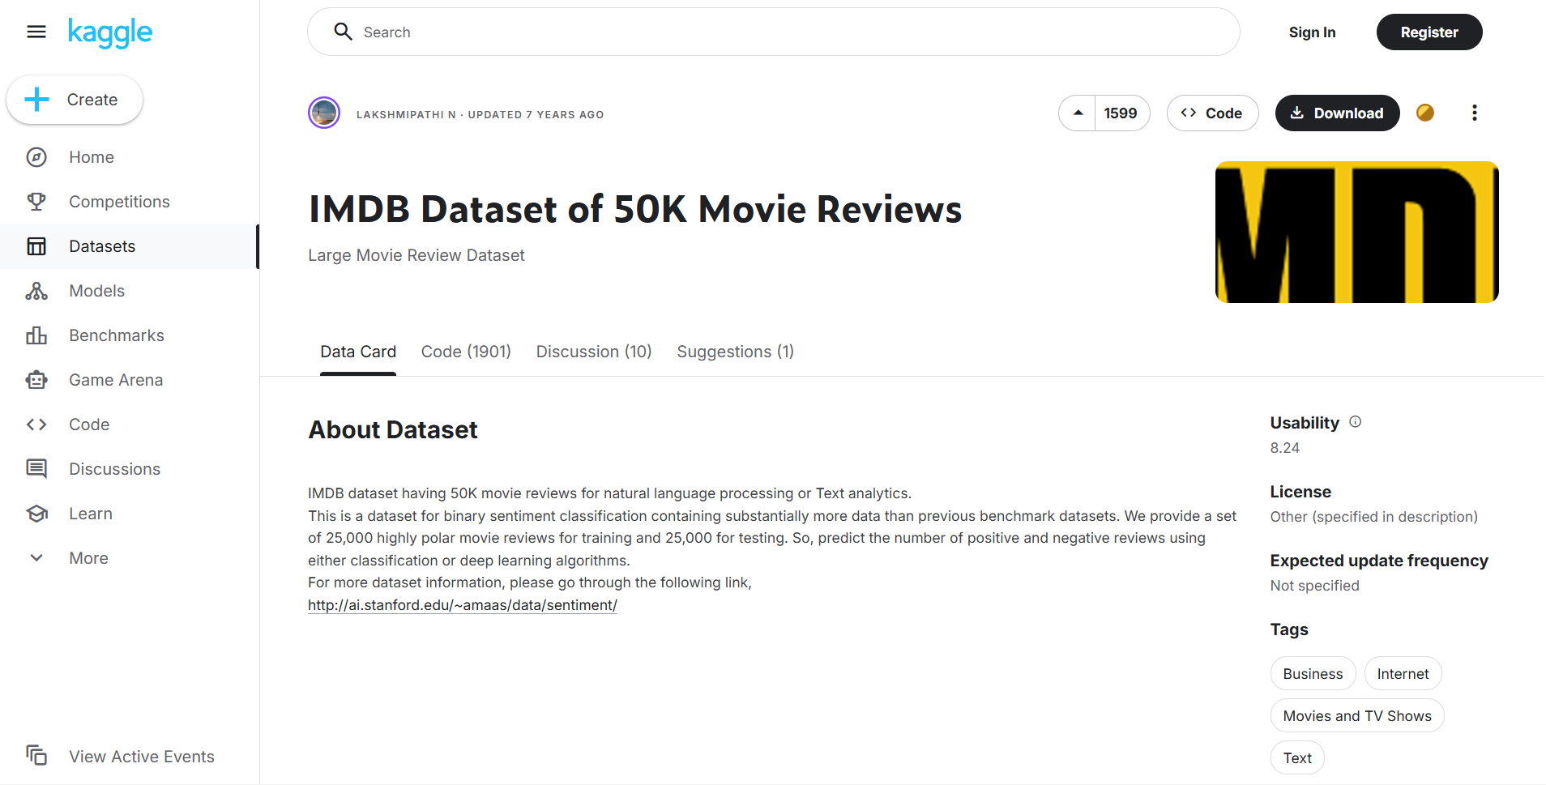
Dataset
IMDB Dataset of 50K Movie Reviews
Task: Sentiment Classification
Total number of classes: 2 (Positive / Negative)
Total number of samples: 50,000 movie reviews
Data characteristics: Highly polar reviews (clearly positive or negative)

Slide 3
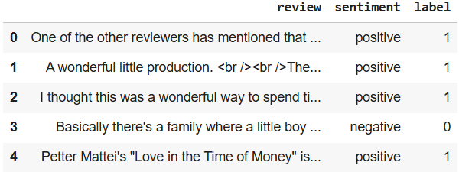
Dataset

Slide 4
Model : DistilBERT
DistilBERT is a lightweight version of BERT
Architecture type: Encoder-only Transformer
Built using Knowledge Distillation
Teacher–Student framework:
Teacher: BERT
Student: DistilBERT

Slide 5
Model Architecture & Compression
Same as BERT:
Hidden size
Number of attention heads
Key simplifications:
Transformer layers reduced by half (12 → 6)
Token-type embeddings removed
Pooler layer removed
66M parameters ( 40% ↓)

Slide 6
Training via Knowledge Distillation
Pre-trained on the same corpus as BERT
Student initialization:
Copy every other layer from the teacher (BERT)
Training objective: Triple Loss
Distillation loss (L_ce): matches teacher soft predictions
MLM loss (L_mlm): preserves language modeling ability
Cosine embedding loss (L_cos): aligns hidden representations

Slide 7
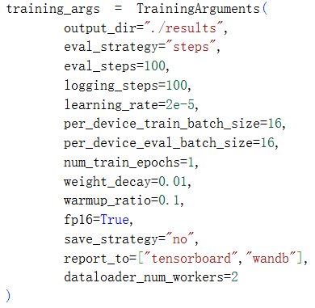
Fit

Slide 8
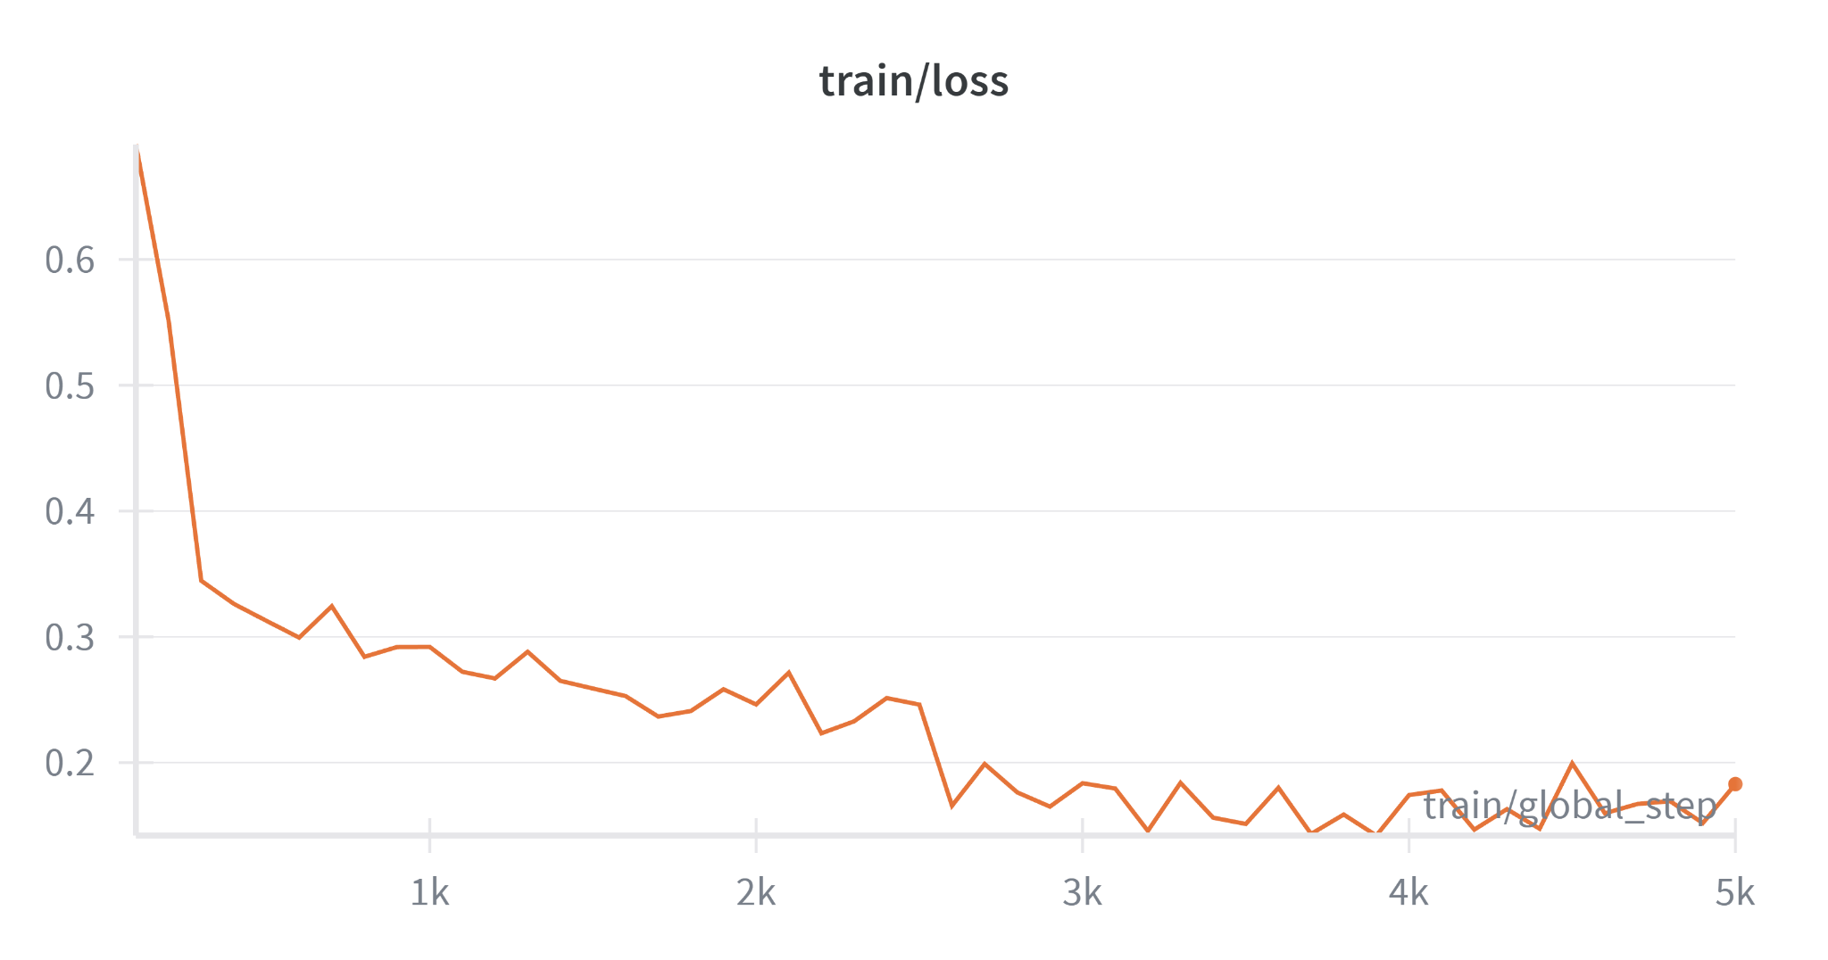
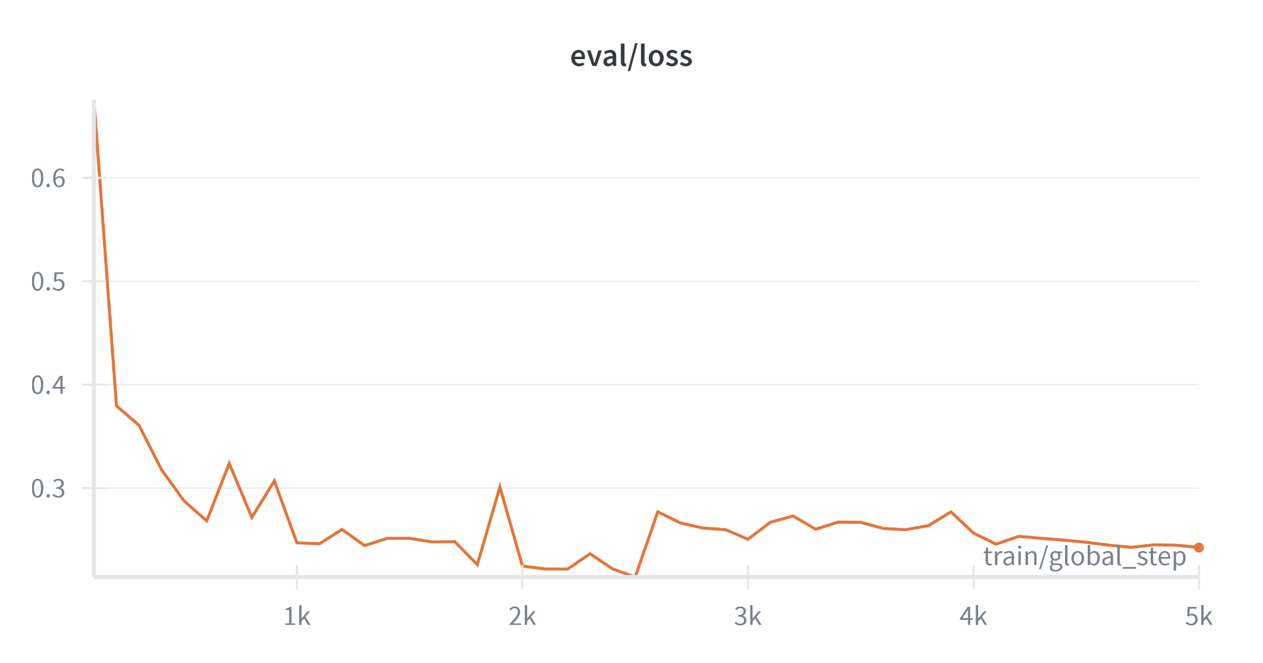
Train loss : 0.1829
Valid loss : 0.2436

Slide 9
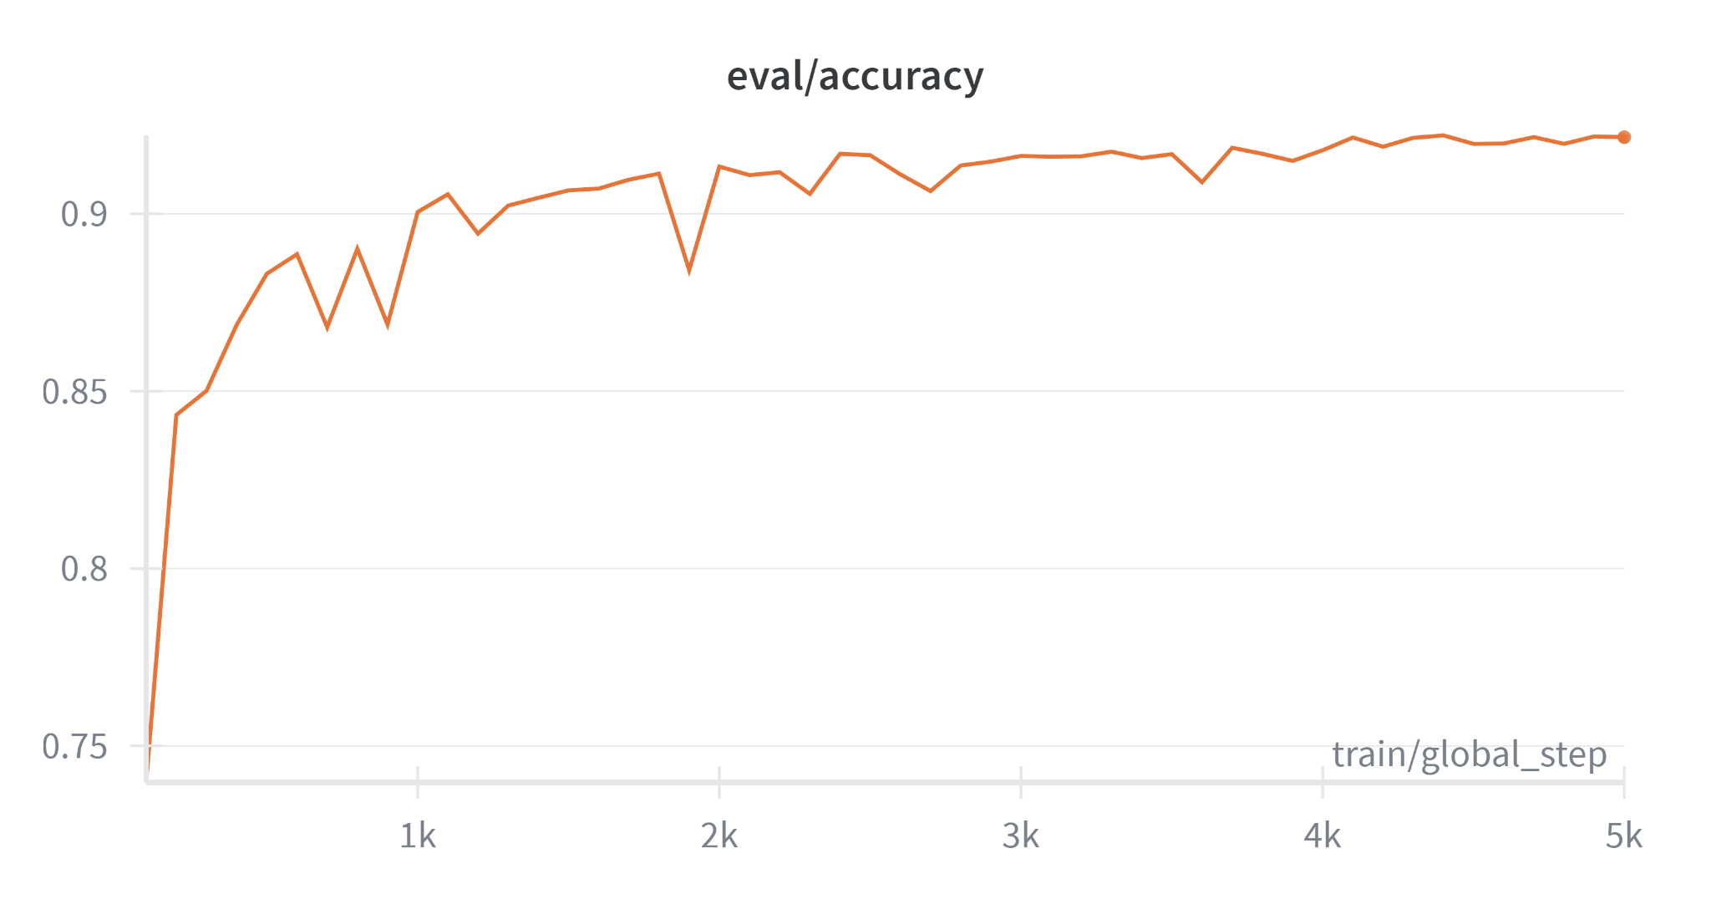
Valid acc: 0.9118

Slide 10
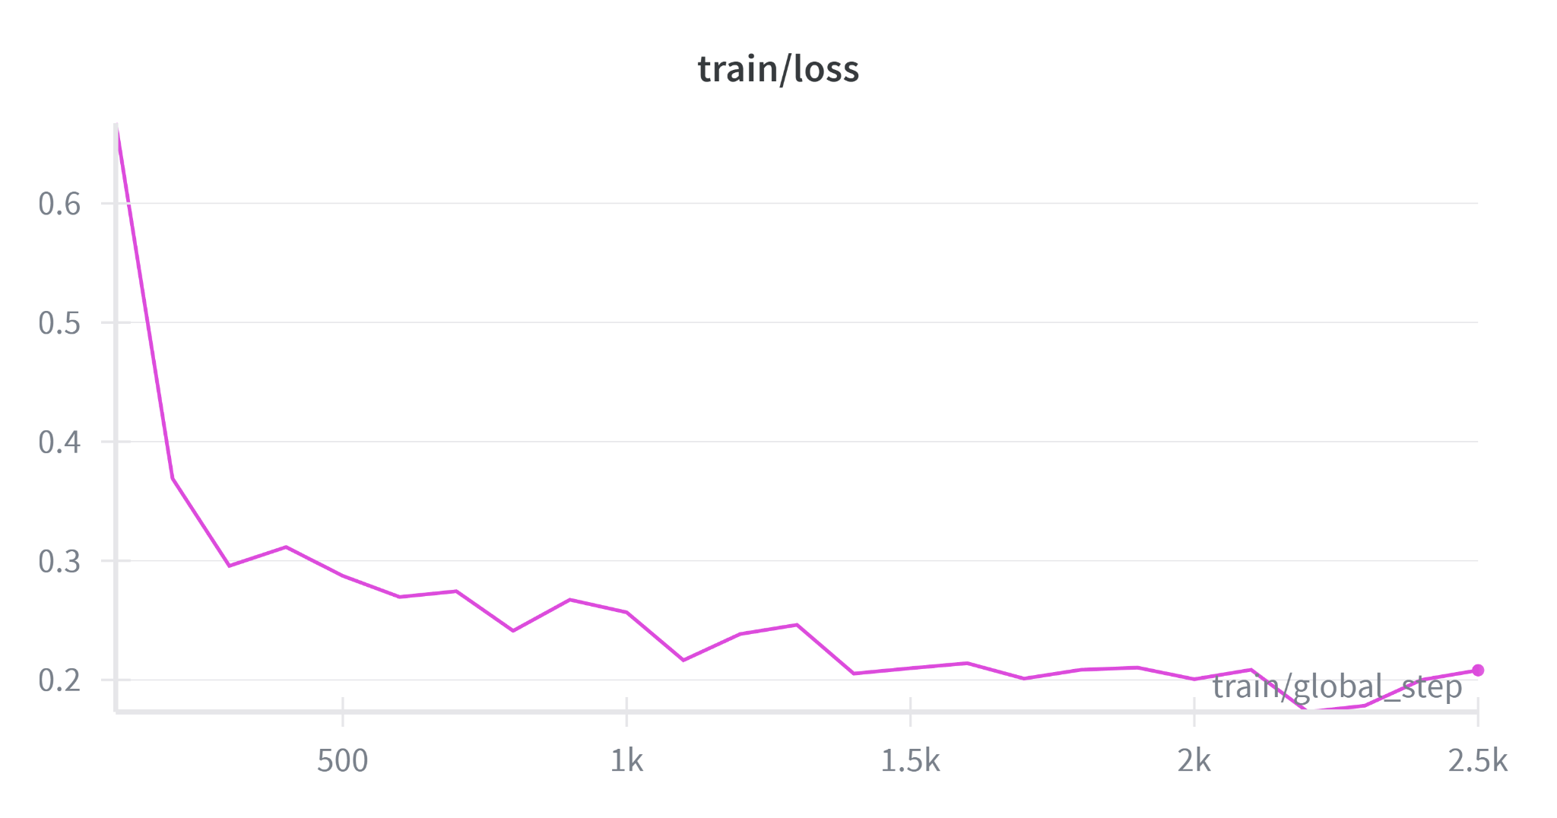
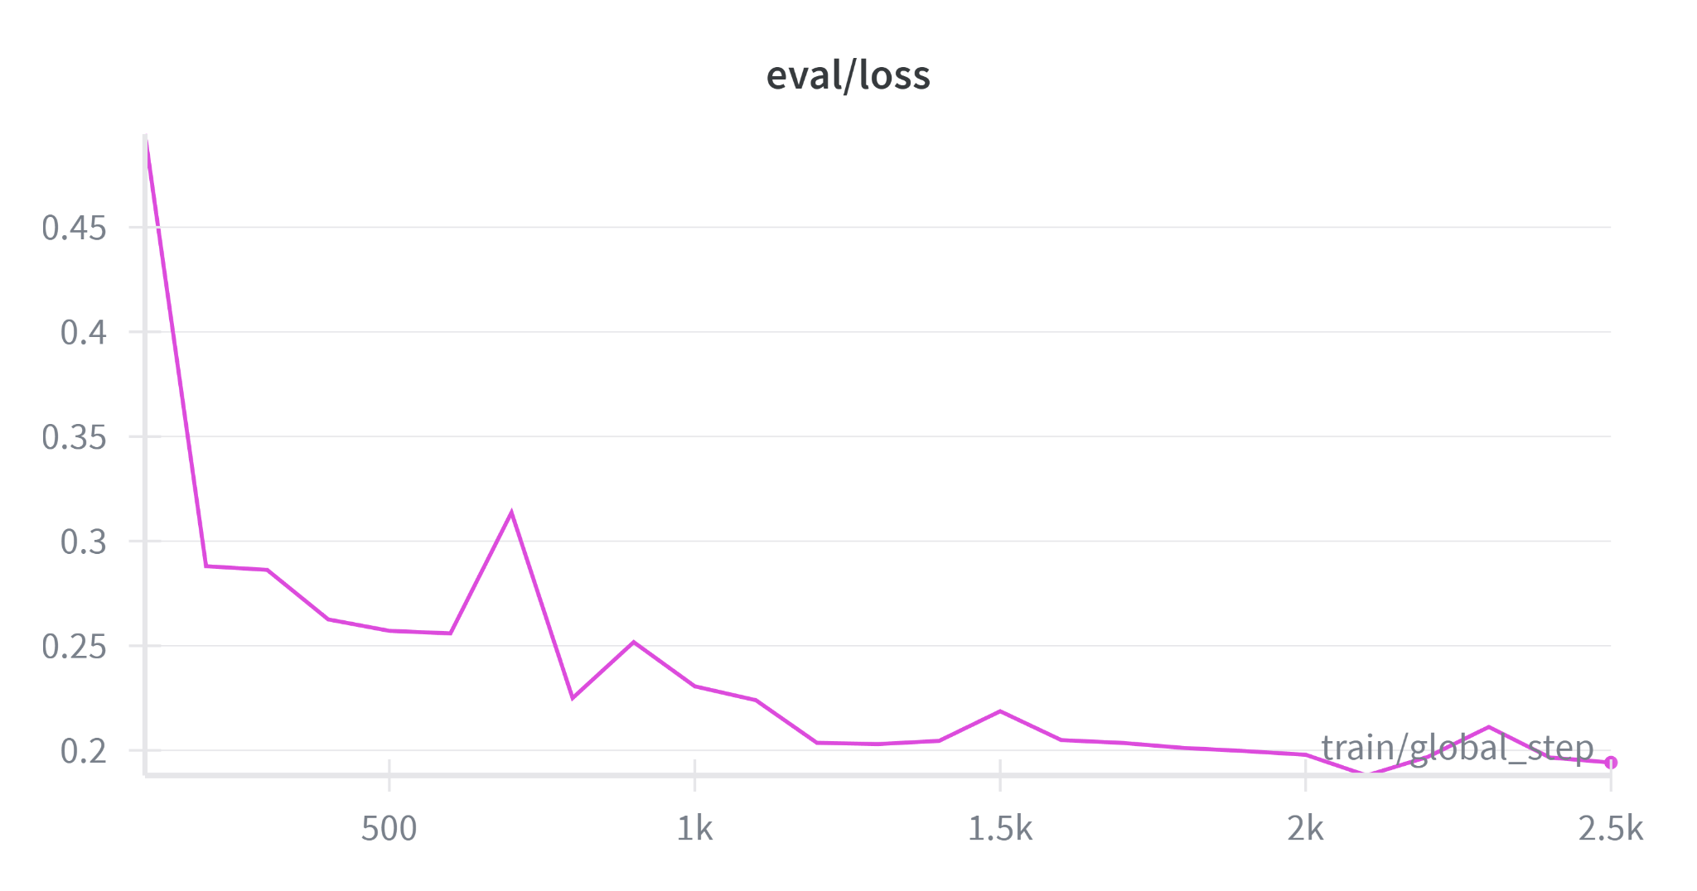
Train loss : 0.2018
Valid loss : 0.1974

Slide 11
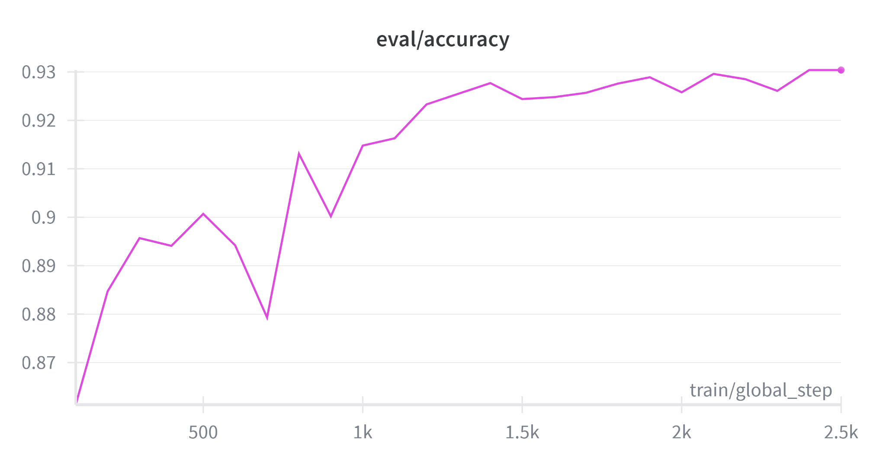
Valid acc: 0.9308

Slide 12
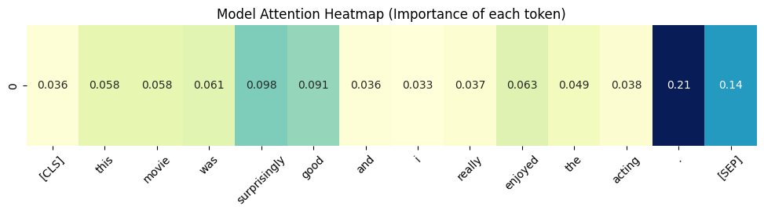
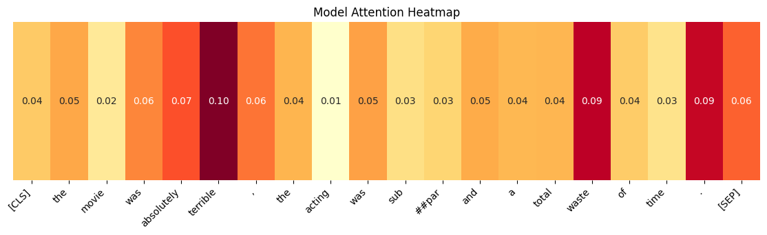

Slide 13
| **SPOILERS**Actually based on the novel "The Brick Foxhole" about a gay man who was murdered by a GI... | Positive | Negative [X]
| I had high hopes for this movie, because I enjoyed the book so much. However, I don't think I would ... | Negative | Positive [X]
| This review owes its existence entirely to a review. We take a weekly TV magazine to see what is com... | Positive | Negative [X]
| This is the first non-zombie subgenre review ive done but this movie is worth doing a review for. Di... | Negative | Positive [X]
| "Scientists at a remote lab experiment on (insert scaly creature here) and create out of control mon... | Negative | Positive [X]
| Yes, indeed we have a winner- a winner in best dumb-action-movie!<br /><br />The only reason I chose... | Positive | Negative [X]

Slide 14
Potential issues
語意陷阱:諷刺、反話、雙重否定
長度限制:評論太長
標籤衝突:文字充滿負面詞(恐怖、噁心)但標籤
為正面增加特定類型(如恐怖片)的訓練資料量
主觀偏差:評論者語氣委婉
過擬合 (Overfitting) 風險：後期Validation Loss的下降速度趨緩，甚至有輕微波動，增加Epoch可能導致模型僅記住訓練資料。

Slide 15
About To Try
嘗試更強大的模型（如 RoBERTa）
採用能處理長文本的架構
資料增強，增加語氣多樣性

